Slide 1
Alpha
Garbage
A Simple Solution to garbage detection & classification.

Slide 2
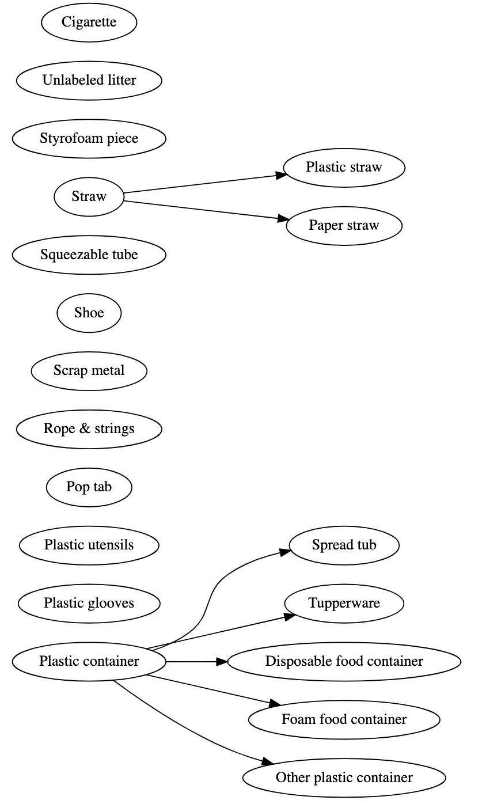
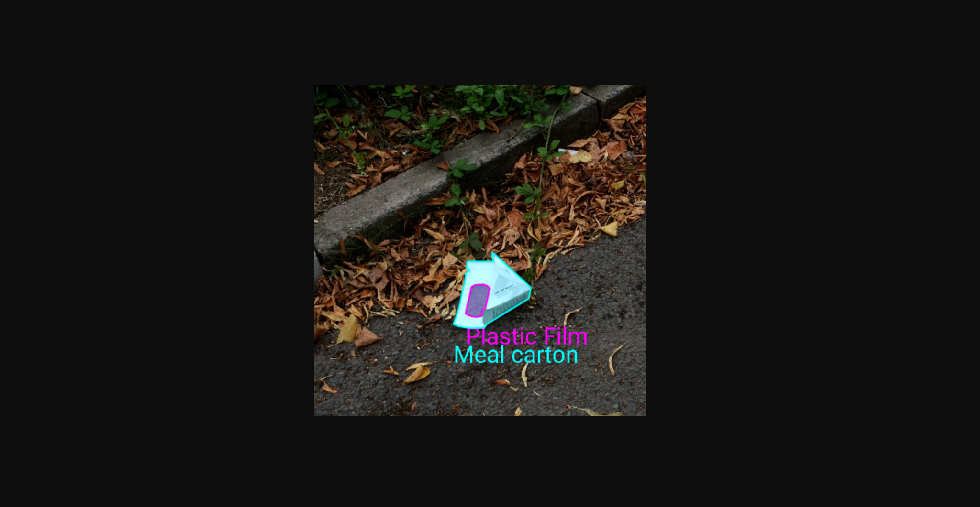
Project goal
Alpha
Garbage
Boundary/Object detection
Garbage type classification
A snapshot of the categories

Slide 3
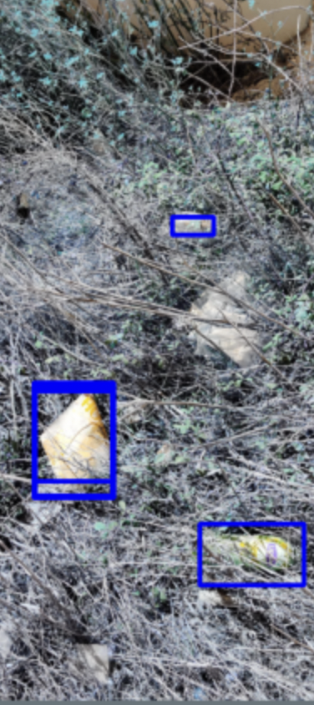
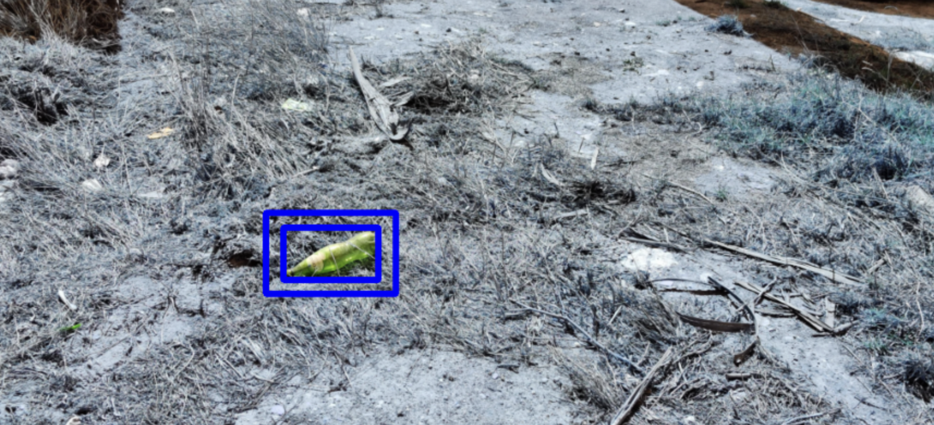
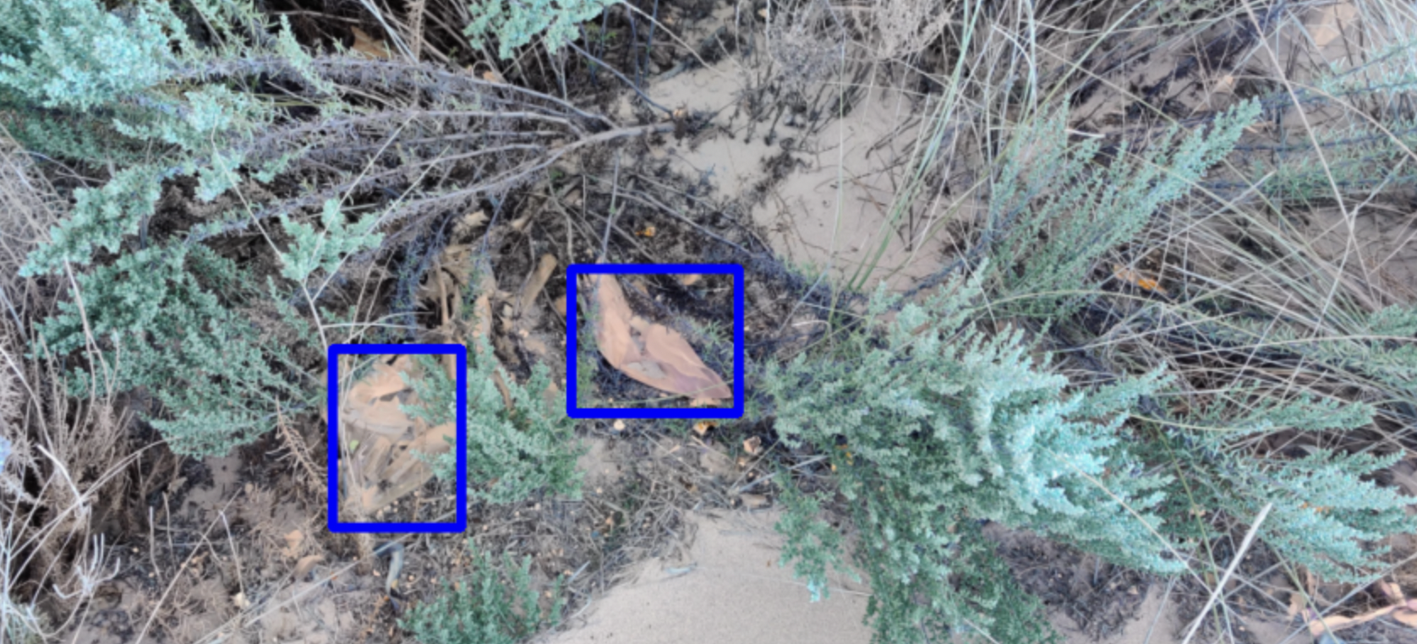
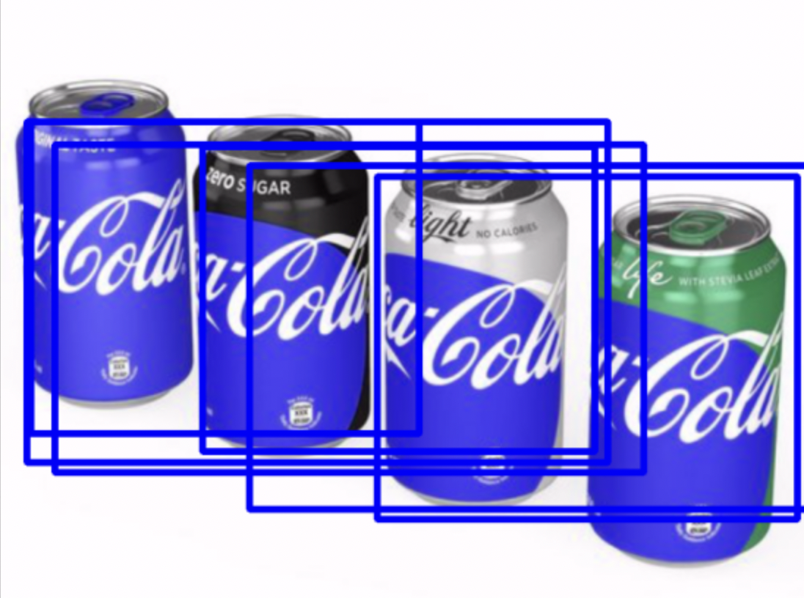
What we did to try and achieve the goal
Alpha
Garbage
RetinaNet
Boundary detection
Bad performance when garbage are gathered/ covered
Slow to train
MobileNetV2
ViT

Slide 4
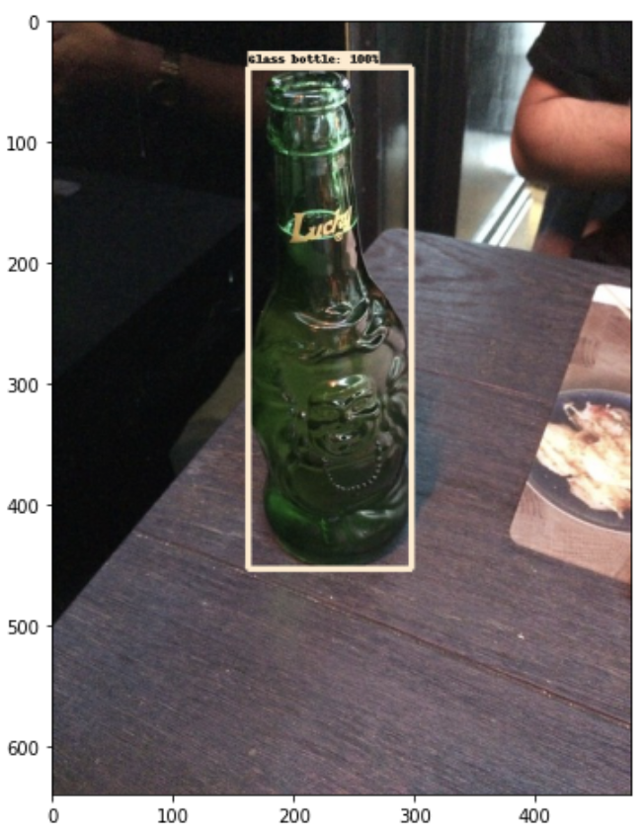
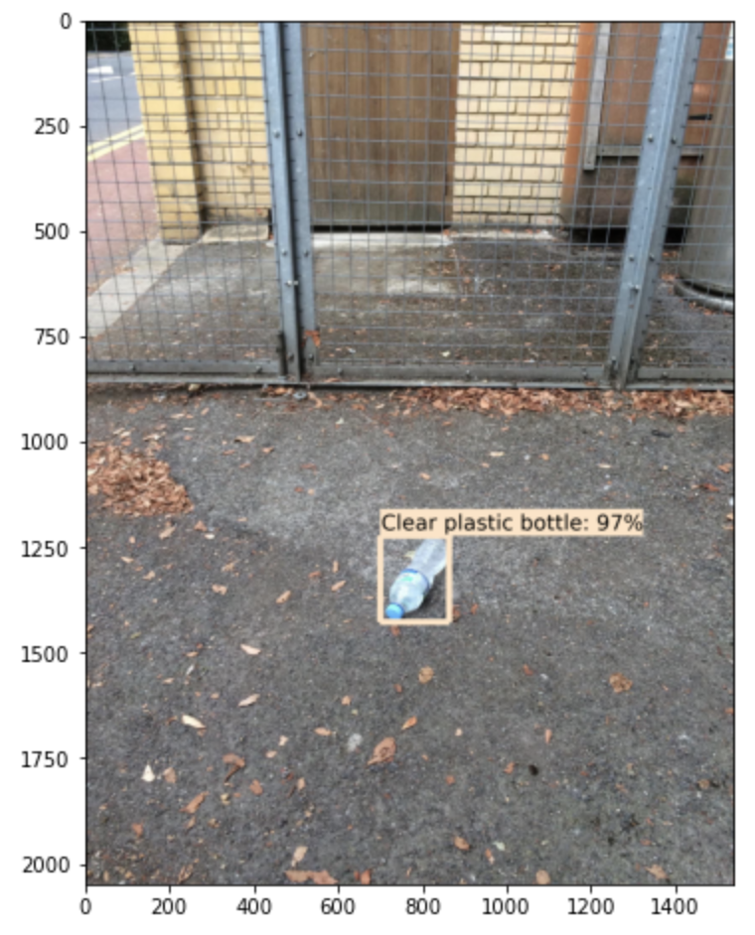
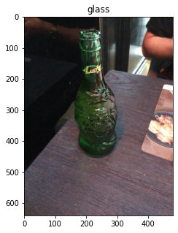
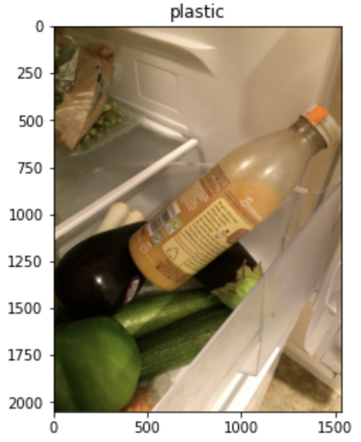
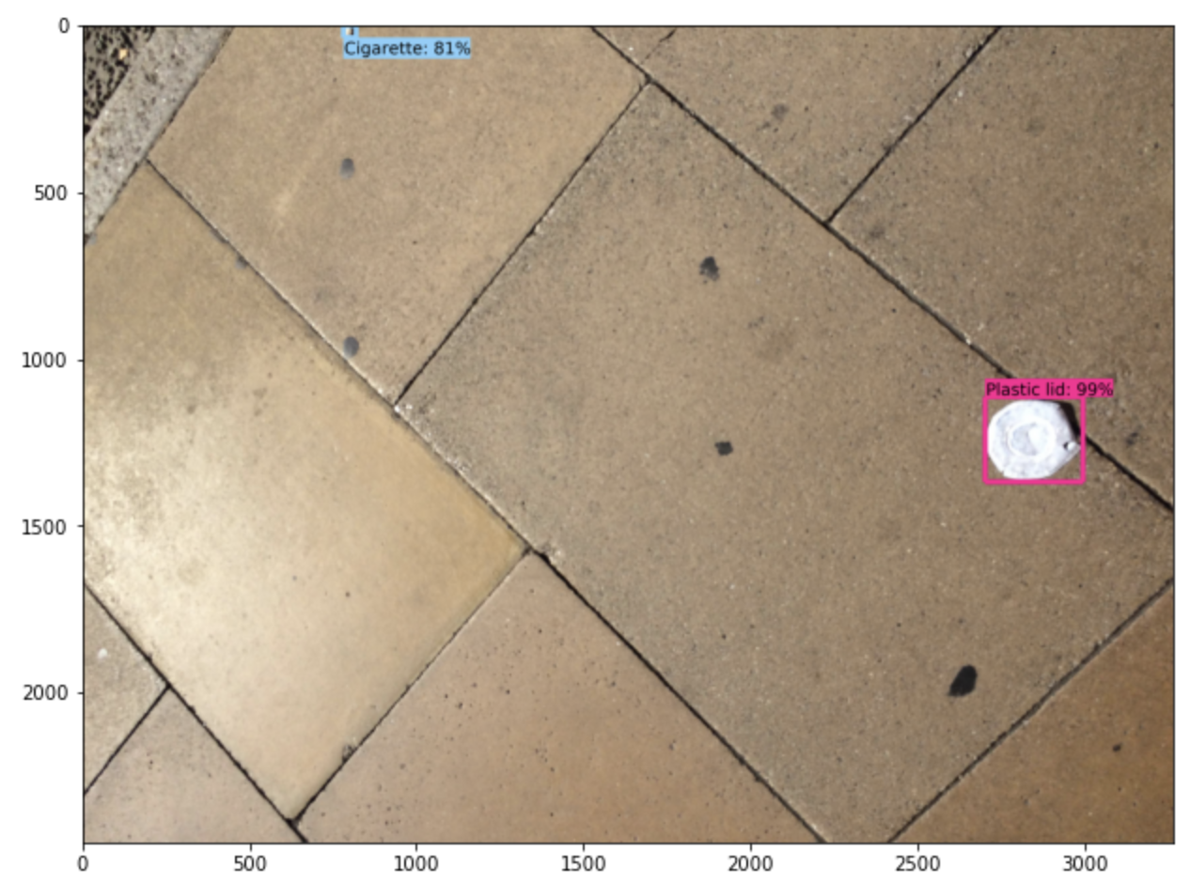
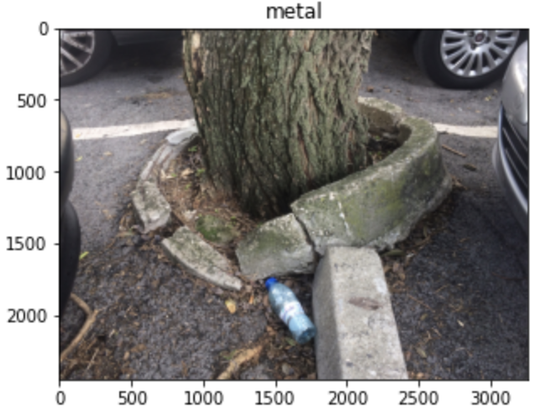
What we did to try and achieve the goal
Alpha
Garbage
RetinaNet
MobileNetV2
ViT
Leveraged from ssd_mobilenet_v2_coco
Fine-tuned the last layer to TACO dataset
Perform bad for garbages combined with fresh foods
Leveraged from google/vit-base-patch16-224-in21k
Fine-tuned with the garbage classes dataset
Proform bad for complex backgrounds

Slide 5
Performance metrics
Alpha
Garbage
 | MobileNetV2 | ViT
Accuracy | 92% | 95.6%

Slide 6
What went well & didn’t go well
Alpha
Garbage
What went well
There are powerful models that we can leverage transfer learning
ViT is pretty fast and simple for fine-tuning
Didn’t go well
Some of the categories do not exist in pre-built model, so we did a mapping to make it fit
RetinaNet and MobileNetV2 are slow, hard to tune hyperparameters
ViT can not be used to detect the objects

Slide 7
Possible improvements
Alpha
Garbage
Overall level:
More garbage class type
More accurate boundary detection
Model level:
RetinaNet is sensitive to learning rate, using lr_scheduler to control learning rate
More hyperparameter tuning

Slide 8
Thank You!
Alpha
Garbage

